Slide 1
Chapter 8
SQL – A Relational Database Language
Data Definition in SQL
Retrieval Queries in SQL
  Simple SQL Queries
  Aliases, * and DISTINCT, Unspecified WHERE-clause
  Set Operations, Nesting of Queries, Set Comparisons
  The EXISTS function, NULLs, Explicit Sets
  Aggregate Functions and Grouping
  Substring Comparisons, Arithmetic, ORDER BY
  Summary of SQL Queries

Slide 2
(cont.)
Specifying Updates in SQL
Relational Views in SQL
Creating Indexes in SQL
Embedding SQL in a Programming Language
Recent Advances in SQL

Slide 3
The SQL Language and Statements
Official name:International Standard Database Language SQL(1999) /* 課本第四版使用的 */
(最新的是 SQL 2003).
In short,SQL-99
Statement:
  May continue over several lines
  Terminate with a semicolon(;)
  May contain a comment starting with an exclamation mark(!) or a double hyphen(-); it may however vary in different systems.

Slide 4
1. Data Definition in SQL
Used to CREATE, DROP, and ALTER the descriptions of the tables(relations) of a database
CREATE TABLE:
  Specifies a new base relation by giving it a name, and specifying each of its attributes and their data types(INTEGER, FLOAT, DECIMAL(I,j), CHAR(n), VARCHAR(n))
  A constraint NOT NULL may be specified on an attribute

Slide 5
(cont.)
Example:
CREATE TABLE DEPARTMENT
( DNAME VARCHAR(10) NOT NULL,
DNUMBER INTEGER NOT NULL,
MGRSSN CHAR(9),
MGRSTARTDATE CHAR(9));

Slide 6
(cont.)
  One important constraint missing from the CREATE TABLE command is that of specifying the primary key attributes, secondary keys, and referential integrity constraints(foreign keys)
  Key attributes can be specified via the CREATE UNIQUE INDEX command
  More recent SQL systems can specify primary keys and referential integrity constraints

Slide 7
(cont.)
DROP TABLE:
  Used to remove a relation(base table) and its definition
  The relation can no longer be used in queries, updates, or any other commands since its description no longer exists
  Example:
  DROP TABLE DEPENDENT;

Slide 8
(cont.)
ALTER TABLE:
  Used to add an attribute to one of the base relations
  The news attribute will have NULLs in all the tuples of the relation right after the command is executed; hence, the NOT NULL constraint is not allowed for such attribute
  Example:
  ALTER TABLE EMPLOYEE ADD JOB VARCHAR(12);
  The database users must still enter a value for the new attribute JOB for each EMPLOYEE tuple.This can be done using the UPDATE command.

Slide 9
2. Retrieval Queries in SQL
SQL has one basic statement for retrieving information from a database; the SELECT statement
This is not the same as the SELECT operation of the relational algebra
Important distinction between SQL and the formal relational model; SQL allows a table(relation) to have two or more tuples that are identical in all their attribute values
Hence, an SQL relation(table) is a multi-set(sometimes called a bag) of tuples; it is not a set of tuples

Slide 10
(cont.)
SQL relations can be constrained to be sets by using the CREATE UNIQUE INDEX command, or by using the DISTINCT option
Basic form of the SQL SELECT statement is called a mapping or a SELECT-FROM-WHERE block
SELECT <attribute list>
FROM <table list>
WHERE <condition>

Slide 11
(cont.)
<attribute list> is a list of attribute names whose values are to be retrieved by the query
<table list> is a list of the relation names required to process the query
<condition> is a conditional (Boolean)expression that identifier the tuples to be retrieved by the query

Slide 12
2.1 Simple SQL Queries
Basic SQL queries correspond to using the SELECT, PROJECT, and JOIN operations of the relational algebra
ALL subsequent examples use the COMPANY database
Query 0 : Retrieve the birthdate and address of the employee whose name is ‘John B. Smith’

Slide 13
(cont.)
Q0: SELECT BDATE, ADDRESS
FROM EMPLOYEE
WHERE FNAME = ‘John’ AND MINIT = ‘B’
AND LNAME = ‘Smith’;
Similar to a SELECT-PROJECT pair of relational algebra operations; the SELECT-clause specifies the projection attributes and the WHERE-clause specifies the selection condition
However, the result of the query may contain duplicate tuples

Slide 14
(cont.)
Query 1: Retrieve the name and address of all employees who work for the ‘Research’ department.
Q1: SELECT FNAME,LNAME,ADDRESS
FROM EMPLOYEE,DEPARTMENT
WHERE DNAME = ‘Research’ AND
DNUMBER = DNO
Similar to a SELECT-PROJECT-JOIN sequence of relational algebra operations

Slide 15
(cont.)
(DNAME = ‘Research’) is a selection condition (corresponds to a SELECT operation in relational algebra)
(DNUMBER = DNO) is a join condition (corresponds to a JOIN operation in relational algebra)

Slide 16
(cont.)
Query 2: For every project located in ‘Stafford’ list the project number, the controlling department number, and the department manager’s last name, address, and birthdate
Q2:
SELECT
PNUMBER,DNUM,LNAME,BDATE,ADDRESS
FROM
PROJECT,DEPARTMENT,EMPLOYEE
WHERE
DNUM = DNUMBER AND MGRSSN = SSN AND
PLOCATION = ‘Stafford’

Slide 17
(cont.)
In Q2,there are two join conditions
The join condition DNUM = DNUMBER relates a project to its controlling department
The join condition MGRSSN = SSN relates the controlling department to the employee who manages that department

Slide 18
2.2 Aliases, * and DISTINCT, Unspecified WHERE-clause
In SQL, we can use the same name for two(or more) attributes as long as the attributes are in different relations
A query that refers to two or more attributes with the same name must qualify the attribute name with the relation name by prefixing the relation name to the attribute name
Example:
  EMPLOYEE.NAME or DEPARTMENT.DNAME

Slide 19
(cont.)
ALIASES:
  Some queries need to refer to the same relation twice
  In this case,aliases are given to the relation name
Query 8: For each employee, retrieve the employee’s name, and the name of his or her immediate supervisor.
Q8:
SELECT E.FNAME,E.LNAME,S.FNAME,S.LNAME
FROM EMPLOYEE E S
WHERE E.SUPERSSN = S.SSN
** FROM 也可寫作 (不同版本)
FROM EMPLOYEE AS E, EMPLOYEE AS S

Slide 20
(cont.)
In Q8,the alternate relation names E and S are called aliases for the EMPLOYEE relation
We can think of E and S as two different copies of the EMPLOYEE relation; E represents employees in the role of supervisees and S represents employees in the role of supervisor.
Aliasing can also be used in any SQL query for convenience

Slide 21
(cont.)
UNSPECIFIED WHERE-clause:
  A missing WHERE-clause indicates no condition;hence, all tuples of the relations in the FROM-clause are selected
  This is equivalent to the condition WHERE TRUE
Query 9: Retrieve the SSN values for all employees.
Q9:
SELECT SSN
FROM EMPLOYEE

Slide 22
(cont.)
  If more than one relation is specified in the FROM-clause and there is no join condition,then the CARTESIAN PRODUCT of tuples is selected
Example:
Q10:
SELECT SSN,DNAME
FROM EMPLOYEE,DEPARTMENT

Slide 23
(cont.)
  It is extremely important not to overlook specifying any selection and join conditions in the WHERE-clause; otherwise, incorrect and very large relations my result
USE OF *:
  To retrieve all the attribute values of the selected tuples, a * is used, which stands for all the attributes
  Examples:
  Q1C:
  SELECT *
  FROM EMPLOYEE
  WHERE DNO = 5

Slide 24
(cont.)
  Q1D:
  SELECT *
  FROM EMPLOYEE,DEPARTMENT
  WHERE DNAME = ‘Research’ AND
  DNO = DNUMBER
USE OF DISTINCT:
  SQL does not treat a relation as a set;duplicate tuples can appear
  To eliminate duplicate tuples,the keyword DISTINCT is used

Slide 25
(cont.)
  For example, the result of Q11 may have duplicate SALARY values whereas Q11A does not have any duplicate values
  Q11:
  SELECT SALARY
  FROM EMPLOYEE
  Q11A:
  SELECT DISTINCT SALARY
  FROM EMPLOYEE

Slide 26
2.3 Set Operations,Nesting of Queries, Set Comparisons
SET OPERATIONS:
  SQL has directly incorporated some set operations
  There is a union operation(UNION), and in some versions of SQL there are set difference(MINUS) and intersection (INTERSECT) operations
  The resulting relations of these set operations are sets of tuples; duplicate tuples are eliminated from the result
  The set operations apply only to union compatible relations; the two relations must have the same attributes and the attributes and the attributes must appear in the same order

Slide 27
(cont.)
Query 4:Make a list of all project numbers for projects that involve an employee whose last name is ‘Smith’ as a worker or as a manager of the department that controls the project.

Slide 28
(cont.)
Q4:
  (SELECT PNUMBER
  FROM PROJECT,DEPARTMENT,EMPLOYEE
  WHERE DNUM = DNUMBER AND MGRSSN = SSN
  AND LNAME = ‘Smith’)
  UNION
  (SELECT PNUMBER
  FROM PROJECT,WORKS_ON,EMPLOYEE
  WHERE PNUMBER = PNO AND ESSN = SSN AND
  LNAME = ‘Smith’);

Slide 29
(cont.)
NESTING OF QUERIES:
  A complete SELECT query, called a nested query, can be specified within the WHERE-clause of another query, called the outer query
  Many of the previous queries can be specified in an alternative form using nesting
  Query 1: Retrieve the name and address of all employees who work for the ‘Research’ department.
  Q1:SELECT FNAME,LNAME,ADDRESS
  FROM EMPLOYEE
  WHERE DNO IN (SELECT DNUMBER
  FROM DEPARTMENT
  WHERE DNAME = ‘Research’);

Slide 30
(cont.)
  The nested query selects the number of the ‘Research’ department
  The outer query select an EMPLOYEE tuple is its DNO value is in the result of either nested query
  The comparison operator IN compares a value v with a set ( or multi-set) of values V, and evaluates to TRUE if v is one of the elements in V
  In general, we can have several levels of nested queries
  A reference to an unqualified attribute refers to the relation declared in the innermost nested query

Slide 31
(cont.)
  In this example,the nested query is not correlated with the outer query
CORRELATED NESTED QUERIES:
  If a condition in the WHERE-clause of a nested query references an attribute of a relation declared in the outer query, the two queries are said to be correlated
  The result of a correlated nested query is different for each tuple(or combination of tuples) of the relation(s) the outer query

Slide 32
(cont.)
  Query 12: Retrieve the name of each employee who has a dependent with the same first name as the employee.
  Q12:
  SELECT E.FNAME,E.LNAME
  FROM EMPLOYEE E
  WHERE E.SSN IN (SELECT ESSN
  FROM DEPENDENT
  WHERE ESSN = E.SSN AND
  E.FNAME = DEPENDENT.NAME)

Slide 33
(cont.)
  In Q12, the nested query has a different result for each tuple in the outer query
  A query written with nested SELECT….FROM…WHERE… blocks and using the = or IN comparison operators can always be expressed as a single block query. For example,Q12 may be written as in Q12 A
  Q12A:
  SELECT E.FNAME, E.LNAME
  FROM EMPLOYEE E, DEPENDENT D
  WHERE E.SSN = D.ESSN AND
  E.FNAME = D.DEPENDENT.NAME

Slide 34
(cont.)
  The original SQL as specified for SYSTEM R also had a CONTAINS comparison operator, which is used in conjunction with nested correlated queries
  This operator was dropped from the language,possibly because of the difficulty in implementing it efficiently
  Most implementations of SQL do not have this operator
  The CONTAINS operator compares two sets of values, and returns TRUE if one set contains all values in the other set

Slide 35
(cont.)
Query 3:Retrieve the name of each employee who works on all the projects controlled by department number 5.
  Q3:
  SELECT FNAME,LNAME
  FROM EMPLOYEE
  WHERE((SELECT PNO
  FROM WORKS_ON
  WHERE SSN=ESSN)
  CONTAINS
  (SELECT PNUMBER
  FROM PROJECT
  WHERE DNUM=5));

Slide 36
(cont.)
  In Q3,the second nested query, which is not correlated with the outer query,retrieves the project numbers of all projects controlled by department 5
  The first nested query,which is correlated,retrieves the project numbers on which the employee works,which is different for each employee tuple because of the correlation

Slide 37
2.4 The EXISTS function,NULLs,Explicit Sets
THE EXISTS FUNCTION:
  EXISTS used to check whether the result of a correlated nested query is empty(contains no tuples) or not
  We can formulate Query 12 in an alternative form that uses EXISTS as Q12B below
  Query 12:Retrieve the name of each employee who has a dependent with the same first name as the employee

Slide 38
(cont.)
  Q12B:
  SELECT FNAME.LNAME
  FROM EMPLOYEE
  WHERE EXISTS(SELECT *
  FROM DEPENDENT
  WHERE SSN = ESSN AND
  FNAME = DEPENDENT_NAME)

Slide 39
(cont.)
Query 6: Retrieve the names of employees who have no dependents.
  Q6:
  SELECT FNAME,LNAME
  FROM EMPLOYEE
  WHERE NOT EXISTS(SELECT *
  FROM DEPENDENT
  WHERE SSN=ESSN)
  The Q6,the correlated nested query retrieves all DEPENDENT tuples related to an EMPLOYEE tuple.IF none exist,the EMPLOYEE tuple is selected
  EXISTS is necessary for the expressive power of SQL

Slide 40
(cont.)
EXPLICIT SETS:
  It is also possible to use an explicit set of values in the WHERE-clause rather than a nested query
  Query 13: Retrieve the social security numbers of all employees who work on project number 1, 2, or 3
  Q13:
  SELECT DISTINCT ESSN
  FROM WORKS_ON
  WHERE PNO IN (1,2,3)

Slide 41
(cont.)
NULLS IN SQL QUERIES:
  SQL allows queries that check if a value is NULL (missing or undefined or not applicable)
  SQL uses IS or IS NOT to compare NULLs because it considers each NULL value distinct from other NULL values,so equality comparison is not appropriate
  Query 14: Retrieve the names of all employees who do not have supervisors
  Q14:
  SELECT FNAME,LNAME
  FROM EMPLOYEE
  WHERE SUPERSSN IS NULL
  NOTE:If a join condition is specified, tuples with NULL values for the join attributes are not included in the result

Slide 42
2.5 Aggregate Functions and Grouping
AGGREGATE FUNCTIONS:
  Include COUNT,SUM,MAX,MIN, and AVG
  Query 15:Find the maximum salary, the minimum salary, and the average salary among all employees.
  Q15:
  SELECT
  MAX(SALARY),MIN(SALARY),AVG(SALARY)
  FROM EMPLOYEE
  Some SQL implementations may not allow more than one function in the SELECT-clause

Slide 43
(cont.)
  Query 16:Find the maximum salary,the minimum salary, and the average salary among employees who work for the ‘Research’ department.
  Q16:
  SELECT
  MAX(SALARY),MIN(SALARY),AVG(SALARY)
  FROM EMPLOYEE,DEPARTMENT
  WHERE DNO=DNUMBER AND
  DNAME=‘Research’

Slide 44
(cont.)
  Queries 17 and 18: Retrieve the total number of employees in the company (Q17), and the number of employees in the ‘Research’ department(Q18).
  Q17:
  SELECT COUNT(*)
  FROM EMPLOYEE
  Q18:
  SELECT COUNT(*)
  FROM EMPLOYEE,DEPARTMENT
  WHERE DNO = DNUMBER AND
  DNAME = ‘Research’

Slide 45
Attribute + Aggregate Func. not allowed in SELECT
Select FName, LName, Max(Salary)
From Employee, Department
Where ………………….
直覺上輸出應該是最高薪的員工名字和其薪水。但其實有二因素，使得此語法不能被使用。
There may more than one tuple having the max salary.
It becomes meaningless when other functions (e.g., count() and avg() are involved.
但在有 Group By 時，則是合法的 (如下頁).

Slide 46
(cont.)
GROUPING:
  In many cases,we want to apply the aggregate functions to subgroups of tuples in a relation
  Each subgroup of tuples consists of the set of tuples that have the same value for the grouping attribute(s)
  The function is applied to each subgroup independently
  SQL has a GROUP BY-clause for specifying the grouping attributes,which should also appear in the SELECT-clause (Oracle, SQL/server, Access 都有這要求，就是 Select 句子中的 attributes (除 aggregate functions 之外)，亦必須出現在 GroupBy 中才能執行。而 MySQL 則沒有此要求)

Slide 47
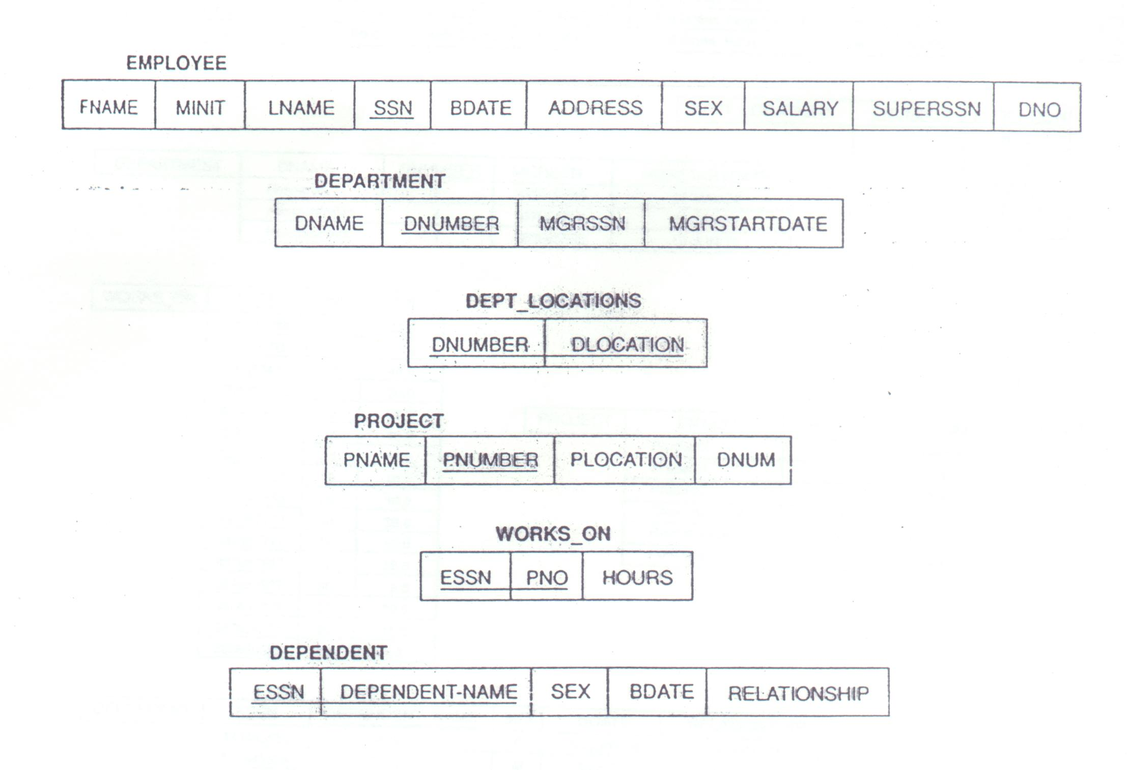
Figure 7.5

Slide 48
(cont.)
  Query 20: For each department,retrieve the department number, the number of employees in the department, and their average salary
  Q20:
  SELECT DNO, COUNT(*), AVG(SALARY)
  FROM EMPLOYEE
  GROUP BY DNO
  In Q20, the EMPLOYEE tuples are divided into groups—each group having the same value for the grouping attribute DNO

Slide 49
(cont.)
  The COUNT and AVG functions are applied to each such group of tuples separately
  The SELECT-clause includes only the grouping attribute and the functions to be applied on each group of tuples
  A join condition can be used in conjunction with grouping
  Query 21: For each project, retrieve the project number, project name, and the number of employees who work on that project.

Slide 50
(cont.)
  Q21:
  SELECT PNUMBER,PNAME,COUNT(*)
  FROM PROJECT,WORKS_ON
  WHERE PNUMBER = PNO
  GROUP BY PNUMBER,PNAME
  In this case, the grouping and functions are applied after the joining of the two relations

Slide 51
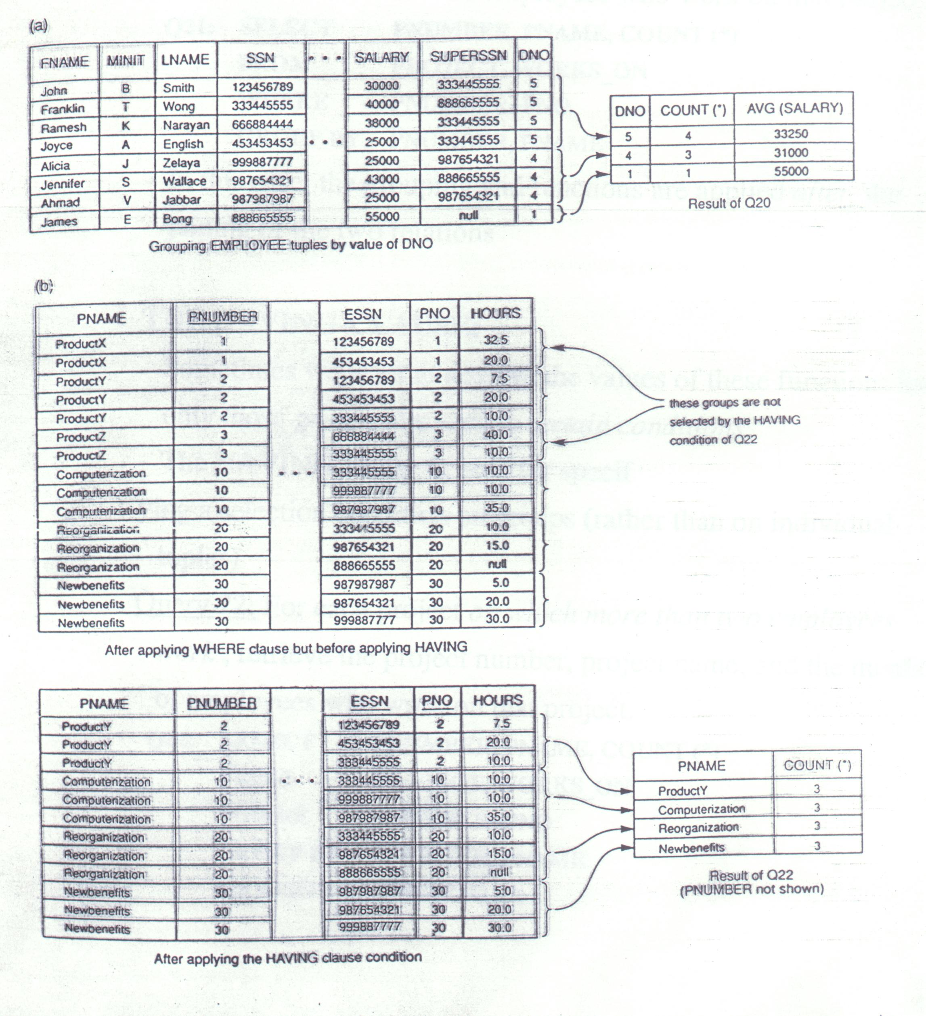
Figure8.4

Slide 52
(cont.)
THE HAVING-CLAUSE:
  Sometimes we want to retrieve the values of these functions for only those groups that satisfy certain conditions
  The HAVING-clause is used for specifying a selection condition on groups (rather than on individual tuples)
  Query 22: For each project on which more than two employees work,retrieve the project number, project name, and the number of employees who work on that project.

Slide 53
(cont.)
  Q22:
  SELECT PNUMBER,PNAME,COUNT(*)
  FROM PROJECT,WORKS_ON
  WHERE PNUMBER=PNO
  GROUP BY PNUMBER,PNAME
  HAVING COUNT(*)>2

Slide 54
2.6 Substring Comparisons,Arithmetic,ORDER BY
SUBSTRING COMPARISON:
  The LIKE comparison operator is used to com,pare partial strings
  Two reserved characters are used: ’%’ (or ‘*’ in some implementations)replaces an arbitrary number of characters, and ‘_’ replaces a single arbitrary character
  Query 25:Retrieve all employees whose address is in Houston, Texas.Here, the value of the ADDRESS attribute must contain the substring ‘Houston,TX’

Slide 55
(cont.)
  Q25:
  SELECT FNAME,LNAME
  FROM EMPLOYEE
  WHERE ADDRESS LIKE ‘%Houston,TX %’
  Query 26: Retrieve all employees who were born during the 1950s.Here, ‘5’ must be the 7th character of the string(according to our format for date), so the BDATE value is ‘___5_’, with each underscore as a place holder for a single arbitrary character.

Slide 56
(cont.)
  Q26:
  SELECT FNAME,LNAME
  FROM EMPLOYEE
  WHERE BDATE LIKE ‘___5_’
  The LIKE operator allows us to get around the fact that each value is considered atomic and indivisible;hence, in SQL, character string attribute values are not atomic

Slide 57
(cont.)
ARITHMETIC OPERATIONS:
  The standard arithmetic operators ‘+’, ‘-’,’*’, and ‘/’ (for addition, subtraction, multiplication, and division, respectively) can be applied to numeric values in an SQL query result
  Query 27: Show the effect of giving all employees who work on the ‘ProductX’ project a 10% raise.
  Q27:
  SELECT FNAME,LNAME,1.1*SALARY
  FROM EMPLOYEE,WORKS_ON,PROJECT
  WHERE SSN = ESSN AND PNO = PNUMBER
  AND PNAME = ‘ProductX’

Slide 58
(cont.)
ORDER BY:
  The ORDER BY clause is used to sort the tuples in a query result based on the values of some attribute(s)
  Query 28: Retrieve a list of employees and the projects each works in, ordered by the employee’s department, and within each department ordered alphabetically by employee last name.
  Q28:
  SELECT DNAME,LNAME,FNAME,PNAME
  FROM
  DEPARTMENT,EMPLOYEE,WORKS_ON,PROJECT
  WHERE DNUMBER = DNO AND SSN = ESSN AND
  PNO = PNUMBER
  ORDER BY DNAME,LNAME

Slide 59
(cont.)
  The default order is in ascending order of values
  We can specify the keyword DESC if we want a descending order;the keyword ASC can be used to explicitly specify ascending order,even though it is the default

Slide 60
2.7 Summary of SQL Queries
A query in SQL can consist of up to six clauses, but only the first two, SELECT and FROM, are mandatory. The clauses are specified in the following order:
SELECT <attribute list>
FROM <table list>
[WHERE <condition>]
[GROUP BY <grouping attribute(s)]
[HAVING <group condition>]
[ORDER BY <attribute list>]

Slide 61
(cont.)
The SELECT-clause lists the attributes or functions to be retrieved
The FROM-clause specifies all relations(or aliases) needed in the query but not those needed in nested queries
The WHERE-clause specifies the conditions for selection and join of tuples from the relations specified in the FROM-clause
GROUP BY specifies grouping attributes
HAVING specifies a condition for selection of groups

Slide 62
(cont.)
ORDER BY specifies an order for displaying the result of a query
A query is evaluated by first applying the WHERE-clause,then GROUP BY and HAVING, and finally the SELECT-clause

Slide 63
3. Specifying Updates in SQL
There are three SQL commands to modify the database; INSERT, DELETE, and UPDATE
INSERT:
  In its simplest form, it is used to add a single tuple to a relation
  Attribute values should be listed in the same order as the attributes were specified in the CREATE TABLE command
  Example:
  U1:
  INSERT INTO EMPLOYEE
  VALUES (‘Richard’, ‘K’, ‘Marini’, ‘653298653’, ’30-DEC-52’, ’98 Oak Forest, Katy, TX’, ‘M’ , 37000, ‘987654321’, 4)

Slide 64
(cont.)
  An alternate form of INSERT specifies explicitly the attribute names that correspond to the values in the new tuple
  Attributes with NULL values can be left out
  Example: Insert a tuple for a new EMPLOYEE for whom we only know the FNAME, LNAME, and SSN attributes
  U1A:
  INSERT INTO EMPLOYEE (FNAME,LNAME,SSN)
  VALUES (‘Richard’, ‘Marini’, ‘653298653’)

Slide 65
(cont.)
  Important Note: Only the constraints specified in the DDL commands are automatically enforced by the DBMS when updates are applied to the database
  Another variation of INSERT allows insertion of multiple tuples in a relation in a single command
  Example: Suppose we want to create a temporary table that has the name, number of employees, and total salaries for each department. A table DEPTS_INFO is created by U3A, and is loaded with the summary information retrieved from the database by the query in U3B

Slide 66
(cont.)
  U3A:
  CREATE TABLE DEPTS_INFO
  (DEPT_NAME VARCHAR(10),
  NO_OF_EMPS INTEGER,
  TOTAL_SAL INTEGER);
  U3B:
  INSERT INTO
  DEPTS_INFO (DEPT_NAME, NO_OF_EMPS,TOTAL_SQL)
  SELECT DNAME,COUNT(*),SUM(SALARY)
  FROM DEPARTMENT,EMPLOYEE
  WHERE DNUMBER = DNO
  GROUP BY DNAME;

Slide 67
(cont.)
Note: The DEPTS_INFO table may not be up-to-date if we change the tuples in either the DEPARTMENT or the EMPLOYEE relations after issuing U3B.We have to create a view (see later) to keep such a table up to date.

Slide 68
(cont.)
DELETE:
  Removes tuples from a relation
  Includes a WHERE-clause to select the tuples to be deleted
  Tuples are deleted from only one table at a time
  A missing WHERE-clause specifies that all tuples in the relation are to be deleted;the table then becomes an empty table
  The number of tuples deleted depends on the number of tuples in the relation that satisfy the WHERE-clause condition

Slide 69
(cont.)
  Examples:
  U4A:DELETE FROM EMPLOYEE
  WHERE LNAME = ‘Brown’
  U4B:DELETE FROM EMPLOYEE
  WHERE SSN = ‘123456789’
  U4C:DELETE FROM EMPLOYEE
  WHERE DNO IN (SELECT DNUMBER
  FROM DEPARTMENT
  WHERE DNAME = ‘Research’)
  U4D:DELETE FROM EMPLOYEE

Slide 70
(cont.)
UPDATE:
  Used to modify attribute values of one or more selected tuples
  A WHERE-clause selects the tuples to be modified
  An additional SET-clause specifies the attributes to be modified and their new values
  Each command modifies tuples in the same relation
  Example:Change the location and controlling department number of project number 10 to ‘Bellaire’ and 5, respectively

Slide 71
(cont.)
  U5:
  UPDATE PROJECT
  SET PLOCATION = ‘Bellaire’, DNUM = 5
  WHERE PNUMBER = 10
  Example: Give all employees in the ‘Research’ department a 10% raise in salary
  U6:
  UPDATE EMPLOYEE
  SET SALARY = SALARY*1.1
  WHERE DNO IN (SELECT DNUMBER
  FROM DEPARTMENT
  WHERE DNAME = ‘Research’)

Slide 72
(cont.)
  In this request, the modified SALARY value depends on the original SALARY value in each tuple
  The reference to the SALARY attribute on the right of = refers to the old SALARY value before modification
  The reference to the SALARY attribute on the left of = refers to the new SALARY value after modification

Slide 73
Defining Views
  A view is a table whose data is (usually)not physically stored. Rather, a view is a virtual structure that refers to rows stored in one or more tables.You can include in a view definition combinations of rows and columns from tables and view definitions in the schema
  A view provides the following advantages:
    Complex queries which tend to occur often, can be made permanent efficiently for easy access.
    Additional security can be added to the database
    Data can be assembled in different groups(organization) for program access and user retrieval

Slide 74
4. Relational Views in SQL
A view is a single virtual table that is derived from other tables
The other tables could be base tables or previously defined view
A view does not necessarily exist in physical form, which limits the possible update operations that can be applied to views
There are no limitations on querying a view
The CREATE VIEW command is used to specify a view by specifying a (virtual) table name and a defining query

Slide 75
(cont.)
The view attribute names can be inherited from the attribute names of the tables in the defining query
Examples:
  V1:
  CREATE VIEW WORKS_ON1
  AS SELECT FNAME,LNAME,PNAME,HOURS
  FROM EMPLOYEE,PROJECT,WORKS_ON
  WHERE SSN = ESSN AND PNO = PNUMBER;

Slide 76
(cont.)
V2:
CREATE VIEW DEPT_INFO
(DEPT_NAME, NO_OF_EMPS, TOTAL_SAL)
AS SELECT DNAME,COUNT(*), SUM(SALARY)
FROM DEPARTMENT,EMPLOYEE
WHERE DNUMBER = DNO
GROUP BY DNAME;
In V1 the names of the view attribute names are inherited
In V2, the view attribute name are listed using a one-to-one correspondence with the entries in the SELECT-clause of the defining query

Slide 77
(cont.)
QUERIES ON VIEWS:
  Example:Retrieve the last name and first name of all employees who work on ‘ProjectX’
  QV1:
  SELECT PNAME,FNAME,LNAME
  FROM WORKS_ON1
  WHERE PNAME = ‘ProjectX’;
  Without the view WORKS_ON1,this query specification would require two join conditions
  A view can be defined to simplify frequently occurring queries

Slide 78
(cont.)
  The DBMS is responsible for keeping the view always up-to date if the base tables on which the view is defined are modified
  Hence, the view is not realized at the time of view definition, but rather at the time we specify a query on the view
  A view is removed using the DROP VIEW command
  Example:
  V1A: DROP VIEW WORKS_ON1;
  V2A: DROP VIEW DEPT_INFO;
  Views can also be used as a security and authorization mechanism(See Chapter 20)

Slide 79
(cont.)
UPDATING OF VIEWS:
  A view update operation may be mapped in multiple ways to update operations on the defining base relations
  The topic of updating views is still an active research area
  Example: Suppose we issue the command in UV1 to update the WORKS_ON1 view by modifying the PNAME attribute of ‘John Smith’ from ‘ProductX’ to ‘ProductY’

Slide 80
(cont.)
  UV1:
  UPDATE WORKS_ON1
  SET PNAME = ‘ProductY’
  WHERE LNAME = ‘Smith’ AND FNAME = ‘John’
  AND PNAME = ‘ProductX’
  This can be mapped into several updates on the base relations to give the desired update on the view.Two possibilities are:
  (1)Change the name of the ‘ProductX’ tuple in the PROJECT relation to ‘ProductY’
    It is quite unlikely that the user who specified the view update UV1 wants the update to be interpreted this way

Slide 81
(cont.)
    (1):
    UPDATE PROJECT
    SET PNAME = ‘ProductY’
    WHERE PNAME = ‘ProductX’
  (2)Relate ‘John Smith’ to the ‘ProductY’ PROJECT tuple in place of the ‘ProductX’ PROJECT tuple
    This is most likely the update the user means
    (2):
    UPDATE WORKS_ON
    SET PNO = (SELECT PNUMBER
    FROM PROJECT
    WHERE PNAME = ‘ProductY’)

Slide 82
(cont.)
    WHERE ESSN = (SELECT SSN
    FROM EMPLOYEE
    WHERE LNAME = ‘Smith’
    AND FNAME = ‘John’)
    AND
    PNO = (SELECT PNUMBER
    FROM PROJECT
    WHERE PNAME = ‘ProductX’)
  Some view updates may not make much sense;for example, modifying the TOTAL_SAL attribute of DEPT_INFO as in UV2

Slide 83
(cont.)
  UV2:
  MODIFY DEPT_INFO
  SET TOTAL_SAL = 100000
  WHERE DNAME = ‘Research’;
  In general, we cannot guarantee that any view can be updated
  A view update is unambiguous only if one update on the base relations can accomplish the desired update effect on the view
  If a view update can be mapped to more than one update on the underlying base relations, we must have a certain procedure to choose the desired update

Slide 84
(cont.)
  We can make the following general observations:
    A view with a single defining table is updatable if the view attributes contain the primary key
    Views defined on multiple tables using joins are generally not updatable
    Views defined aggregate functions are not updatable

Slide 85
5. Creating Indexes in SQL
An SQL base relation generally corresponds to a stored file
SQL has statements to create and drop indexes on base relations
One or more indexing attributes are specified for each index
The CREATE INDEX command is used to specify an index
Each index is given an index name

Slide 86
(cont.)
Example:
  I1: CREATE INDEX LNAME_INDEX
  ON EMPLOYEE(LNAME);
The index entries are in ascending(ASC) order of the indexing attributes;for descending order,the keyword DESC is added
An index can be created on a combination of attributes
Example:
  I2: CREATE INDEX NAMES_INDEX
  ON EMPLOYEE(LNAME ASC, FNAME,
  DESC, MINIT);

Slide 87
(cont.)
Two options on indexes in SQL are UNIQUE and CLUSTER
To specify the key constraint on the indexing attribute or combination of attributes, the keyword UNIQUE is used
Example:
  I3: CREATE UNIQUE INDEX SSN_INDEX
  ON EMPLOYEE(SSN);
This is best done before any tuples are inserted in the relation
An attempt to create a unique index on an existing base table with fail if the current tuples in the table do not obey the constraint

Slide 88
(cont.)
A second option on index creation is to specify that the index is a clustering index using the keyword CLUSTER
A base relation can have at most one clustering index, but any number of non-clustering indexes
Example:
  I4: CREATE INDEX DNO_INDEX
  ON EMPLOYEE(DNO)
  CLUSTER;
A clustering and unique index in SQL is similar to the primary index of Chapter 5

Slide 89
(cont.)
A clustering but non-unique index in SQL is similar to the clustering index of Chapter 5
A non-clustering index is similar to the secondary index of Chapter 5
Each DBMS will have its own index implementation technique; in most cases, some variation of the B⁺-tree data structure is used
To drop an index, we issue the DROP INDEX command
The index name is needed to refer to the index when it is to be dropped
Example:
  I5: DROP INDEX DNO_INDEX;

Slide 90
6. Embedding SQL in a Programming Language
SQL can also be used in conjunction with a general purpose programming language, such as PASCAL, COBOL, or PL/I
The programming language is called the host language
The embedded SQL statement is distinguished from programming language statements by prefixing it with a special character or command so that a preprocessor can extract the SQL statements

Slide 91
(cont.)
In PL/I the keywords EXEC SQL precede any SQL statement
In some implementations, SQL statements are passed as parameters in procedure calls
We will use PASCAL as the host programming language, and a “$” sign to identify SQL statements in the program
Within an embedded SQL command, we may refer to program variables, which are prefixed by a “%” sign
The programmer should declare program variables to match the data types of the database attributes that the program will process
These program variables may or may not have names that are identical to their corresponding attributes

Slide 92
(cont.)
Example: Write a program segment(loop)that reads a social security number and prints out some information from the corresponding EMPLOYEE tuple
  E1: LOOP := ‘Y’;
  While Loop = ‘Y’ do
  begin
  Writeln (‘input social security number:’);
  readln (SOC_SEC_NUM);
  $SELECT
  FNAME, MINIT, LNAME, SSN, BDATE, ADDRESS,
  SALARY
  INTO
  %E.FNAME, %E.MINIT, %E.LNAME, %E.SSN,
  %E.BDATE, %E.ADDRESS, %E.SALARY

Slide 93
(cont.)
  FROM EMPLOYEE
  WHERE SSN = %SOC_SEC_NUM;
  writeln (E.FNAME, E.MINIT, E.LNAME, E.SSN,
  E.BDATE, E.ADDRESS, E.SALARY);
  writeln (‘more social security numbers (Y or N)? ‘);
  readln (LOOP)
  end;
In E1, a single tuple is selected by the embedded SQL query; that is why we are able to assign its attribute values directly to program variables
In general, an SQL query can retrieve many tuples
The concept of a cursor is used to allow tuple-at-a-time processing by the PASCAL program

Slide 94
7. Recent Advances in SQL
  SPECIFYING KEYS AND REFERENTIAL INTEGRITY:
  Some SQL systems allow the specification of keys and referential integrity constraints(foreign keys)
  To allow a relation to have multiple keys, the keys can be numbered 0 (for primary key), and 1, 2, 3, …(for other keys)
  The keyword KEY followed by one or more key numbers specifies that an attribute is a member of the specified keys
  The keyword REFERENCES <relation> <attribute> specifies that an attribute is a foreign key referencing <attribute> of <relation>

Slide 95
(cont.)
  Example:
  CREATE TABLE EMPLOYEE
  ( FNAME VARCHAR(15) KEYMEMBER 1 NOT NULL,
  MINIT CHAR(1) KEYMEMBER 1,
  LNAME VARCHAR(15) KEYMEMBER 1 NOT NULL,
  SSN CHAR(9) KEYMEMBER 0 NOT NULL,
  BDATE CHAR(9),
  ADDRESS VARCHAR(30),
  SEX CHAR(1),
  SALARY INTEGER,
  SUPERSSN CHAR(9) REFERENCES EMPLOYEE.SSN,
  DNO INTEGER REFERENCES
  DEPARTMENT.DNUMBER);

Slide 96
(cont.)
  CREATE TABLE DEPARTMENT
  ( DNAME VARCHAR(10) KEYMEMBER 1
  NOT NULL,
  DNUMBER INTEGER KEYMEMBER 0
  NOT NULL,
  MGRSSN CHAR(9) REFERENCES
  EMPLOYEE.SSN,
  MGRSTARTDATE CHAR(9));

Slide 97
(cont.)
SPECIFYING OUTER JOINS:
  Some SQL systems include the OUTER JOIN operation
  The equality comparison operator = is modified to other symbols (+=, =+, +=+) to specify the various outer joins
  REGULAR JOIN CONDITION:
  EMPLOYEE.DNO = DEPARTMENT,DNUMBER
  This retrieves only those EMPLOYEE tuples related to a DEPARTMENT tuple, and only those DEPARTMENT tuples related to at least one EMPLOYEE tuple

Slide 98
(cont.)
  LEFT OUTER JOIN:
  EMPLOYEE.DNO += DEPARTMENT.DNUMBER
  All EMPLOYEE tuples are retrieved;those not related to a DEPARTMENT tuple are padded with NULLs
  RIGHT OUTER JOIN:
  EMPLOYEE.DNO =+ DEPARTMENT.DNUMBER
  All DEPARTMENT tuples are retrieved; those not related to any EMPLOYEE tuple are padded with NULLs
  FULL OUTER JOIN:
  EMPLOYEE.DNO +=+ DEPARTMENT.DNUMBER
  ALL EMPLOYEE or DEPARTMENT tuples are retrieved

